Slide 1
Digital resources for parents
Notes:
slides 45 -

Slide 2
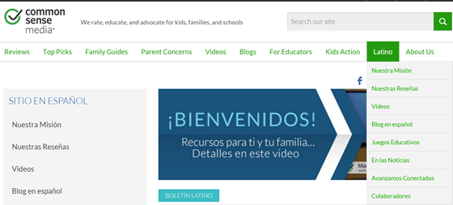
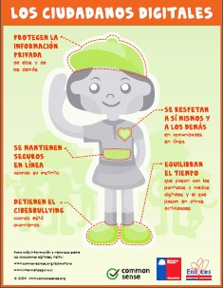
Parenting in the Online World
https://www.commonsensemedia.org/latino
¿Cómo usar la tecnología de forma segura y balanceada?
Notes:
Common Sense Media is a wonderful website with wonderful resources for parents in English and Spanish. The screen shot shows the landing page for the Latino section. Click on and show the video (3:03 minutes).

Slide 3
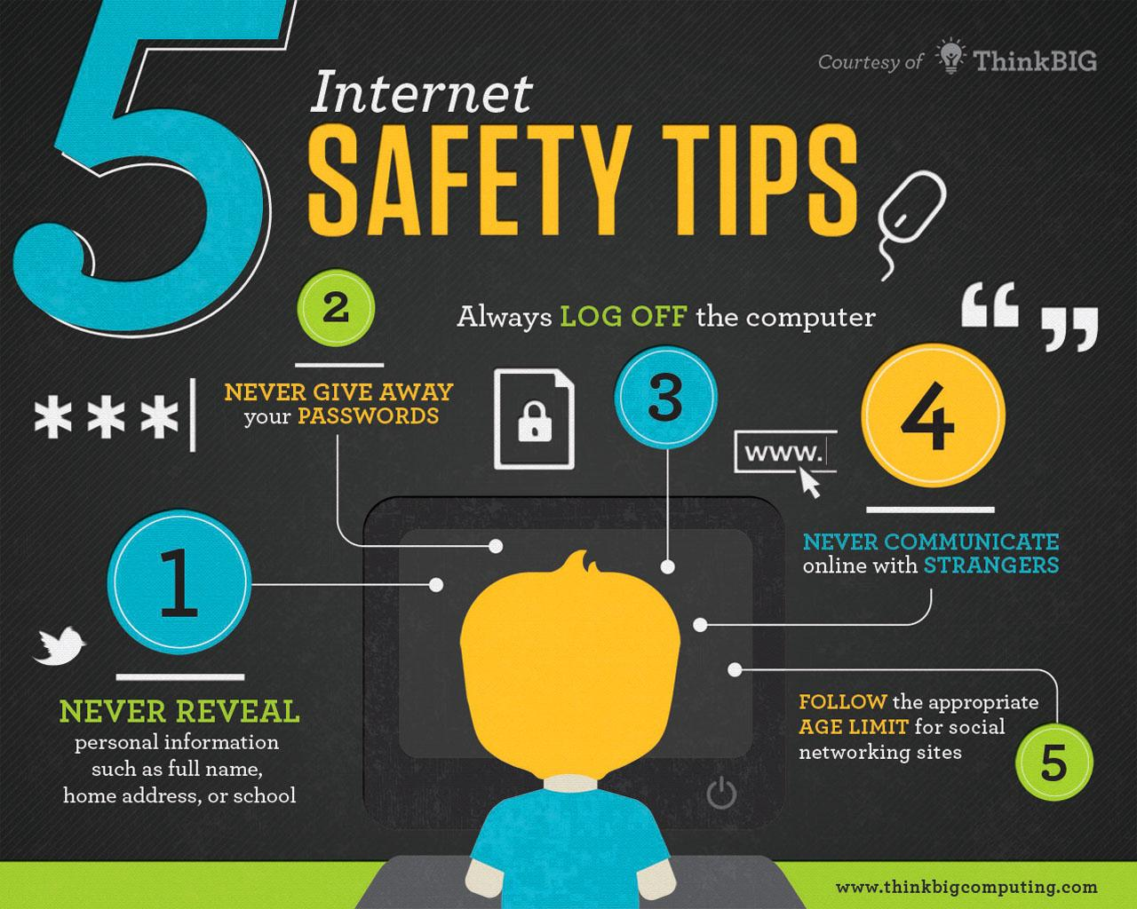

Slide 4
Questions and Answers

Slide 5
Notes:
End of class 2.. Ask if there are any questions or comments.

Slide 6
Additional Resources
How Computer Viruses Work
Como los virus informáticos Trabajo
How Spyware Works
Cómo funciona el software espía
Common Sense Media (English and Spanish)
Netsmartz for Parents (English and Spanish)
YouTube (Google Help)

